Slide 1
“Pray, Persevere, Praise”
Luke 18:28--43

Slide 2
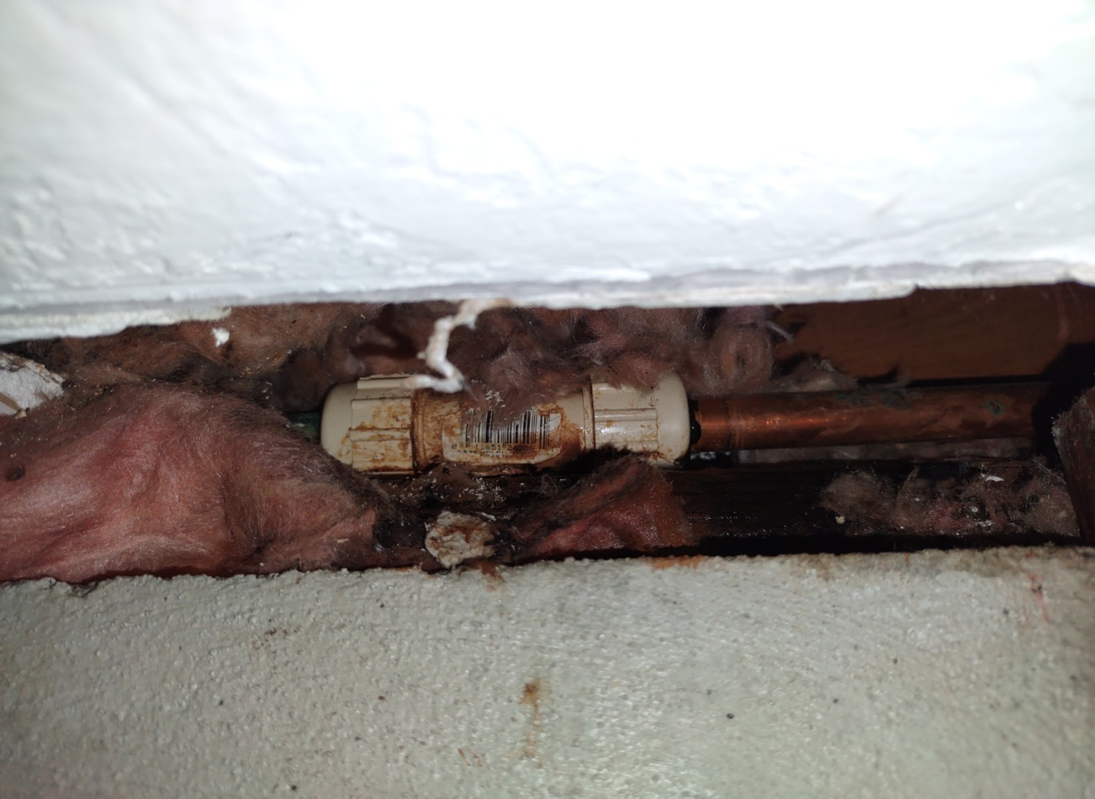
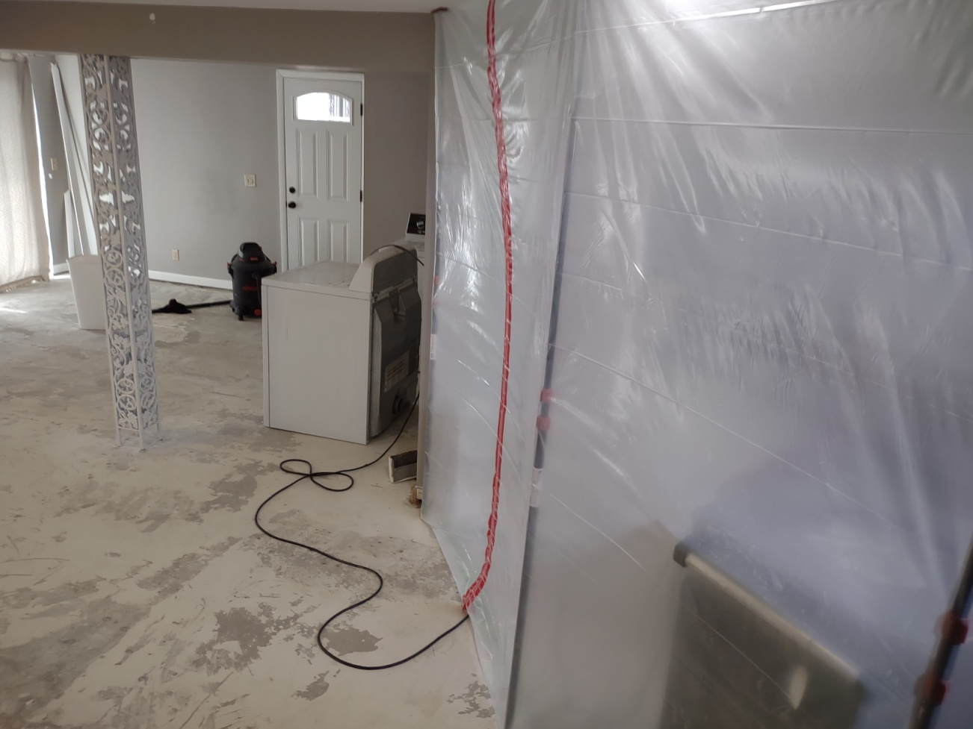
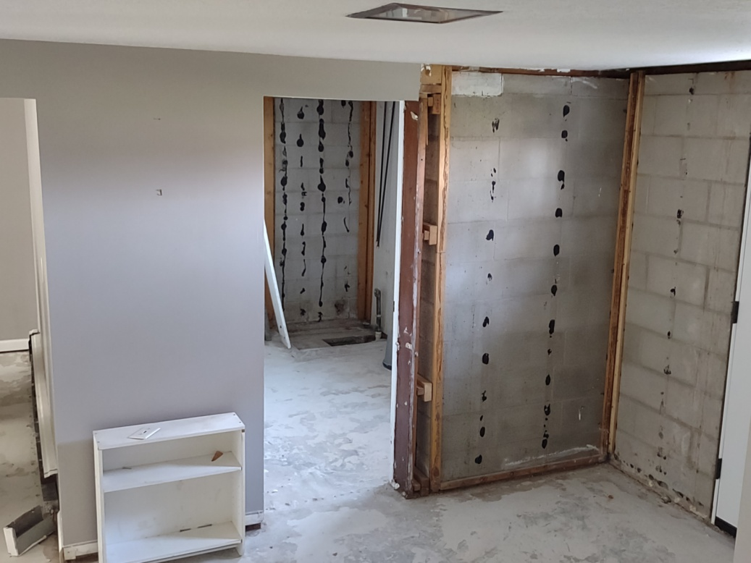
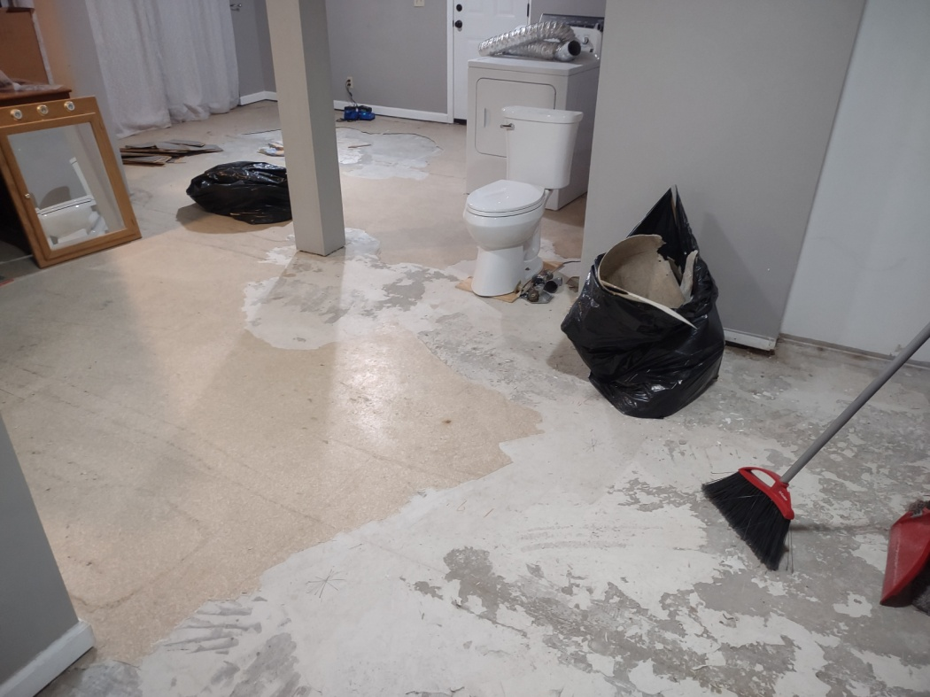
Introduction
An unexpected
house project

Slide 3
Luke 18:28-43
Context: Jesus on God’s kingdom:
  God receives those who are persistent in prayer, humble, and needy.
Themes:
  Kingdom of God; Eternal life; Discipleship; Enlightenment

Slide 4
Luke 18:28-43
Structure (3 scenes):
  Jesus encouraged His disciples
  Jesus prophesied of his death and resurrection in Jerusalem
  Jesus healed a blind man
Structure (3 scenes):
  Jesus encouraged His disciples
  Jesus prophesied of his death and resurrection in Jerusalem
  Jesus healed a blind man

Slide 5
Verses 28--30
POINT:
The promise of God’s kingdom is becoming God’s family (shared life)

Slide 6
Verses 31--33
POINT:
The cost of God’s kingdom is Christ’s suffering

Slide 7
Verse 34
POINT:
One’s eyes have to be opened to the reality of suffering for God’s kingdom

Slide 8
Verses 35--43
POINT:
The effects of God’s kingdom bring Him glory and praise

Slide 9
MAIN IDEA
The family of God will glorify Him through their faith in his promises and his grace in their suffering.
( Correlation: Isaiah 40:3-5 )

Slide 10
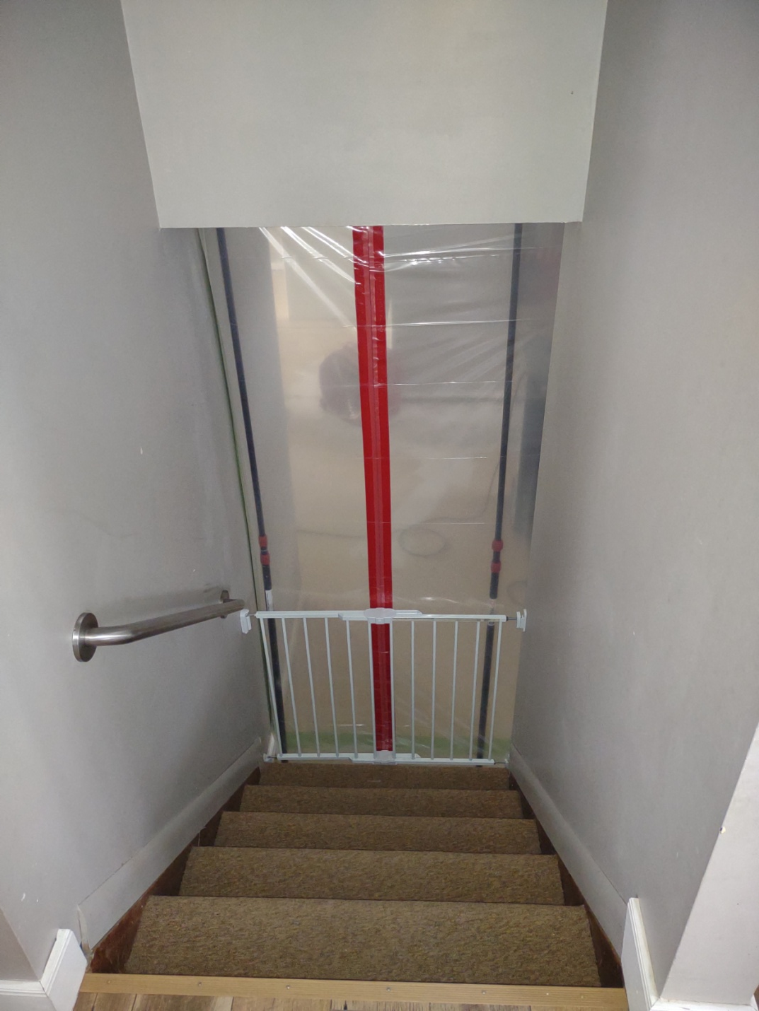
APPLICATION
Pray over God’s Promises
Persevere through the Cost
Praise God for the Effects

