Slide 1
True Greatness
Luke 9:37–50

Slide 2




Introduction
What are some things we need in order to serve others?

Slide 3
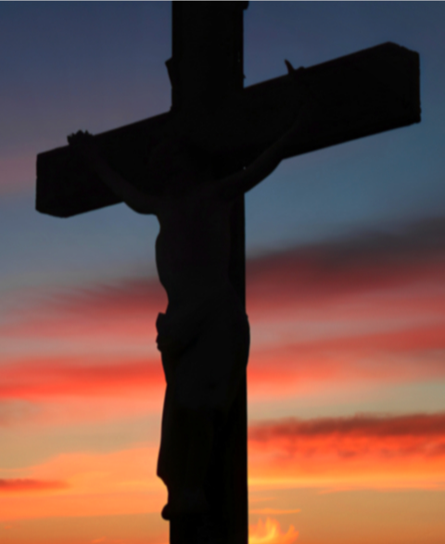
Introduction
One thing: JESUS
His resources:
Love
Joy
Peace
Kindness…

Slide 4
Review—Luke 9:18–36
Death to Self = Jesus is my Life
WE CAN:
Suffer Gracefully
Endure Rejection
Overcome Fleshly Nature
HOPE in the Resurrection

Slide 5
Luke 9:37–50
verses 37–41:
The disciples were “unbelieving and perverted”

Slide 6
Luke 9:37–50
verses 42–43:
Jesus served.
They realized Jesus is God and He is great

Slide 7
Luke 9:37–50
verses 44–45:
The disciples were unbelieving.
They did not believe Jesus would die for their sins.

Slide 8
Luke 9:37–50
verses 46–48:
The disciples were perverted.
They wanted to be great.

Slide 9
MAIN IDEA
True greatness is
being a dependent
son of God.

Slide 10




Application / Conclusion
The Call to Discipleship is a call to:
Love
Joy
Peace
Kindness
In Christ, your identity is Christ

