Slide 1
“Where is Your Faith?”
part 2
Luke 8:49–56

Slide 2

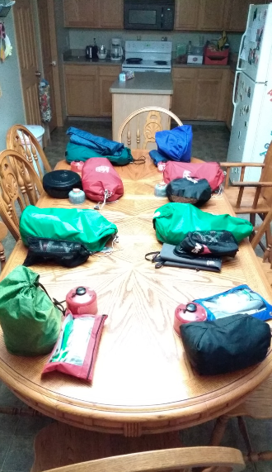


Outdoor Expeditions

Slide 3
Review — Luke 8
Jesus is in control of:
    Circumstances
    Spiritual Condition
    Physical Condition
    Eternal State

Slide 4
Luke 8:49–56
Jesus went to the unclean.
Verbal acknowledgment of Jesus is not enough.
Jesus pursued the man.
Jesus did not back down in the face of spiritual warfare.
The man described the great things God did for him

Slide 5

Main Idea
Jesus has done great things for spiritually oppressed mankind.

Slide 6
Application – The Response
Will you put your faith in Jesus or what is “unclean”?
Takes a willingness to associate with anyone.
Takes a whole-life faith response.
Takes pursuing the lost.

Slide 7

Conclusion
Let us fight the
spiritual battle.
Jesus has overcome.
We are equipped!

