Slide 1
The Great Exchange
2 Corinthians 5:14-21

Slide 2
Introduction--The Conductor
He inspires and compels to action
The call for the Christian life: hear, follow and be transformed by Christ
The transformation will be evidenced by certain things.

Slide 3
Context of 2 Corinthians 5
A divided church
In the midst of the pagan culture, they needed to be reminded of who they are in Christ

Slide 4
2 Corinthians 5:14-15
Compelled by the one who gave new, true life
Experience of that new life puts “self” to death
AN EXCHANGED LIFE

Slide 5
Verse 16
What we see on earth is not the full reality

Slide 6
Verse 17
Old: natural, fleshly, temporary—DEAD
New: spiritual, resurrected, eternal—ALIVE
In Christ: heavenly perspective, right mind, selfless heart, clean hands, Holy Spirit

Slide 7
Verse 18
All our resources—mind, body and spirit—used for God’s glory in service to others

Slide 8
Verse 19
Christ’s invitation—forget old
With the new life comes new purpose: share “word of reconciliation”

Slide 9
Verse 20
Ambassadors: Earth is no longer our home
Can’t contain the message if truly received!
URGENCY

Slide 10
Verse 21
Christ’s atoning sacrifice
IN HIM—God sees a beloved child when he looks at those in Christ
BECOME—Increasing understanding of this in the present time

Slide 11
MAIN IDEA
Those in Christ have a new past, present and future in God’s faithful hands

Slide 12
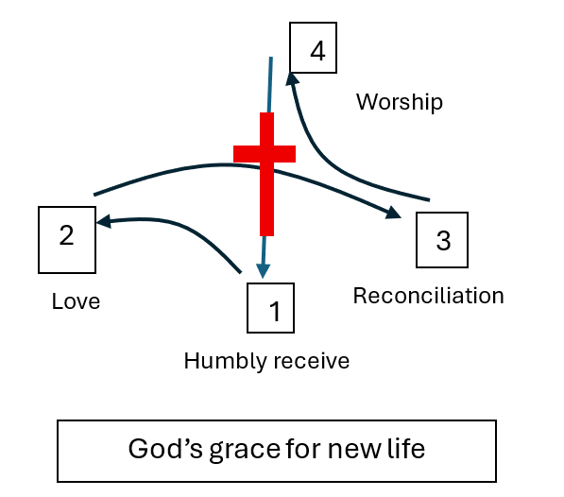
Application: Christ as Conductor

Slide 13
Application
New Past
God is holding nothing against those who are in Christ—We should not either!
Romans 8. We once walked according to the flesh (Be careful to walk by the Spirit now)

Slide 14
Application
New Future
Hope we have for Christ’s presence in heaven!
Ephesians 2

Slide 15
Application
New Present
Love
Share word of reconciliation
Let Him lead

