Slide 1
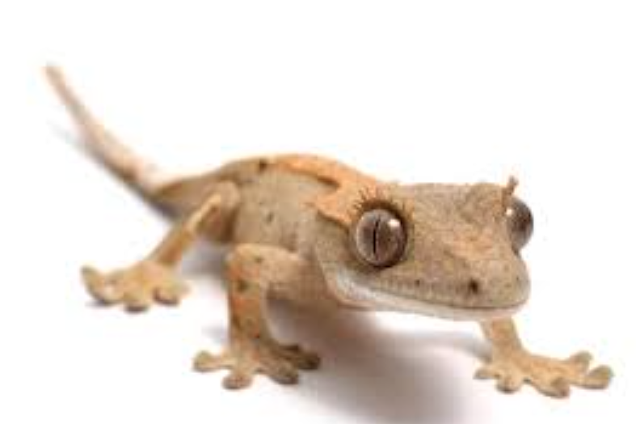
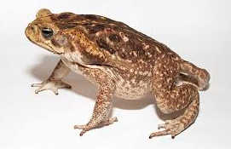
Joy-Filled Discipleship
“Jesus is not the means to an end, He IS the end” -Sandy Mason
VS.
Toad: Waits for Fly
Lizard: Hunts
Fortress
Launching Pad
Make Church “Attractive”
Make Outreach Fun
Conform
Create
Safety 1st
Value Risk
Protect From World
Penetrate into World
Comfort
Mission
Addition
Multiplication

Slide 2
The Call to Discipleship,
part 3
Luke 10:25–42

Slide 3
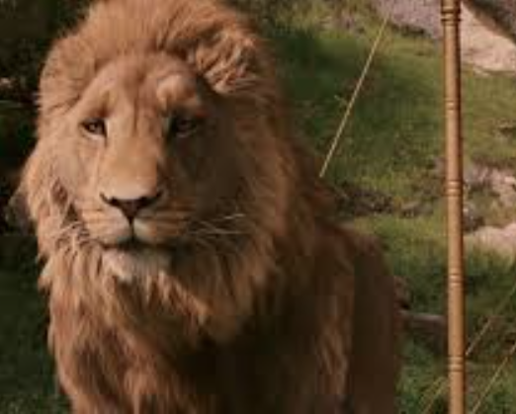
Introduction

Slide 4
Review
“THE KINGDOM OF GOD HAS COME NEAR…”
“TO YOU” ?
Or passing through?

Slide 5
Luke 10:25–42
vs. 25–28
POINT: Disciples recognize their continual need of God’s mercy and grace.

Slide 6
Luke 10:25–42
vs. 25–28
POINT: Disciples recognize their continual need of God’s mercy and grace.
vs. 29–37
POINT: Religious experience and performance does not matter in God’s eyes.

Slide 7
MAIN IDEA
Discipleship is about being with Jesus, not doing things for Him.

Slide 8
Luke 10:25–42
vs. 38–42
POINT: Only relationship with Jesus will not be taken away.
Discipleship is about being with Jesus, not doing things for Him.

Slide 9
Reflection
Are you focused on your relationship with Jesus above all else?
How is He asking you to love Him and others?
What is He asking you to let go of?

Slide 10
Application:
Jesus as the Lion of Judah
“He’s not a tame lion. But He’s good.”

Slide 11


Application:
Being Disciples

