Slide 1
“Child, Arise!”
Luke 8:40–56

Slide 2
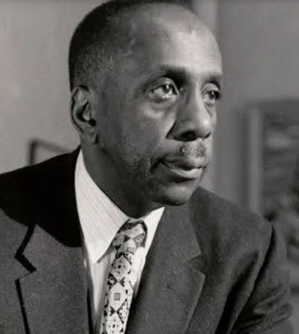
Introduction
“Don’t ask yourself what the world needs. Ask yourself what makes you come alive, and go do that, because what the world needs is people who have come alive.”
Howard Thurman

Slide 3
Review
Jesus is in complete control of:
  Circumstances
  Spiritual realm
  Human Condition

Slide 4
Question
Is your faith fully in Christ?

Slide 5
Luke 8:40–48
POINT: Jesus freed her from:
  Physical ailment
  Rejection by God
  Fear of rejection by man

Slide 6
Luke 8:49–56
Jesus raised the girl to life.
MAIN IDEA: Jesus came to redeem the human condition.
Is this what makes you come alive?

Slide 7
Only Jesus can make you:
Endure through struggles
Acceptable to God
Free from fear of man
Free from fear of death

Slide 8
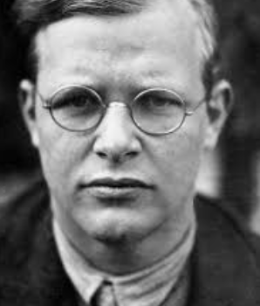
Conclusion — The Response:
Raise your hands of need;
Raise your hands of praise;
Raise your hands of
Service
Dietrich Bonhoeffer

