Slide 2
#252 Nothing But The Blood
What can wash away my sin?
Nothing but the blood of Jesus;
What can make me whole again?
Nothing but the blood of Jesus.
Oh! precious is the flow
That makes me white as snow;
No other fount I know,
Nothing but the blood of Jesus.
Song Used With permission – 7120053 CCLI - 11614006

Slide 3
For my pardon, this I see,
Nothing but the blood of Jesus;
For my cleansing this my plea,
Nothing but the blood of Jesus.
Oh! precious is the flow
That makes me white as snow;
No other fount I know,
Nothing but the blood of Jesus.
Song Used With permission – 7120053 CCLI - 11614006

Slide 4
Nothing can for sin atone,
Nothing but the blood of Jesus;
Naught of good that I have done,
Nothing but the blood of Jesus.
Oh! precious is the flow
That makes me white as snow;
No other fount I know,
Nothing but the blood of Jesus.
Song Used With permission – 7120053 CCLI - 11614006

Slide 5
This is all my hope and peace,
Nothing but the blood of Jesus;
This is all my righteousness,
Nothing but the blood of Jesus.
Oh! precious is the flow
That makes me white as snow;
No other fount I know,
Nothing but the blood of Jesus.
Song Used With permission – 7120053 CCLI - 11614006

Slide 7
#243 When I Survey The Wondrous Cross
When I survey the wondrous cross
On which the Prince of glory died,
My richest gain I count but loss,
And pour contempt on all my pride.
Song Used With permission – 7120053 CCLI - 11614006

Slide 8
Forbid it, Lord, that I should boast,
Save in the death of Christ my God!
All the vain things that charm me most,
I sacrifice them to His blood.
Song Used With permission – 7120053 CCLI - 11614006
Song Used With permission – 7120053 CCLI - 11614006
CCLI - 11614006
sed With permission –

Slide 9
See from His head, His hands, His feet,
Sorrow and love flow mingled down!
Did e’er such love and sorrow meet,
Or thorns compose so rich a crown?
Song Used With permission – 7120053 CCLI - 11614006
Song Used With permission – 7120053 CCLI - 11614006
CCLI - 11614006
sed With permission –

Slide 10
Were the whole realm of nature mine,
That were a present far too small;
Love so amazing, so divine,
Demands my soul, my life, my all.
Song Used With permission – 7120053 CCLI - 11614006
Song Used With permission – 7120053 CCLI - 11614006
CCLI - 11614006
sed With permission –

Slide 12
#131 Wonderful Merciful Saviour
Wonderful Merciful Saviour
Precious Redeemer and Friend
Who would've thought that a Lamb
Could rescue the souls of men
O You rescue the souls of men
Song Used With permission – 7120053 CCLI - 11614006

Slide 13
You are the one that we praise
You are the one we adore
You give the healing and grace
Our hearts always hunger for
O our hearts always hunger for.
Song Used With permission – 7120053 CCLI - 11614006

Slide 14
Counsellor Comforter Keeper
Spirit we long to embrace
You offer hope when
Our hearts have hopelessly lost the way
O we've hopelessly lost the way
Song Used With permission – 7120053 CCLI - 11614006

Slide 15
You are the one that we praise
You are the one we adore
You give the healing and grace
Our hearts always hunger for
O our hearts always hunger for.
Song Used With permission – 7120053 CCLI - 11614006

Slide 16
Almighty Infinite Father
Faithfully loving your own
Here in our weakness
You find us falling before your throne
O we're falling before your throne
Song Used With permission – 7120053 CCLI - 11614006

Slide 17
You are the one that we praise
You are the one we adore
You give the healing and grace
Our hearts always hunger for
O our hearts always hunger for.
Song Used With permission – 7120053 CCLI - 11614006

Slide 19
Yet Not I but Through Christ in Me

Slide 20
What gift of grace is Jesus my Redeemer,
There is no more for heaven now to give,

Slide 21
He is my joy, my righteousness, and freedom,
My steadfast love, my deep and boundless peace,

Slide 22
To this I hold, my hope is only Jesus,
For my life is wholly bound to His,

Slide 23
Oh how strange and divine, I can sing; all is mine–
Yet not I, but through Christ in me.

Slide 24
The night is dark but I am not forsaken,
For by my side, the Savior He will stay,

Slide 25
I labor on in weakness and rejoicing,
For in my need, His power is displayed,

Slide 26
To this I hold, my Shepherd will defend me,
Through the deepest valley He will lead,

Slide 27
Oh the night has been won, and I shall overcome–
Yet not I, but through Christ in me.

Slide 28
No fate I dread, I know I am forgiven,
The future sure, the price it has been paid,

Slide 29
For Jesus bled and suffered for my pardon,
And He was raised to overthrow the grave,

Slide 30
To this I hold, my sin has been defeated,
Jesus now and ever is my plea,

Slide 31
Oh the chains are released, I can sing: I am free–
Yet not I, but through Christ in me.

Slide 32
With every breath I long to follow Jesus,
For He has said that He will bring me home.

Slide 33
And day by day I know He will renew me,
Until I stand with joy before the throne.

Slide 34
To this I hold, my hope is only Jesus,
All the glory evermore to Him!

Slide 35
When the race is complete, still my lips shall repeat:
Yet not I, but through Christ in me.

Slide 36
To this I hold, my hope is only Jesus,
All the glory evermore to Him!

Slide 37
When the race is complete, still my lips shall repeat:
Yet not I, but through Christ in me.

Slide 38
When the race is complete, still my lips shall repeat:
Yet not I, but through Christ in me.

Slide 40
“Ordinary People, Extraordinary God”
part 2
Mark 1:16–20

Slide 41
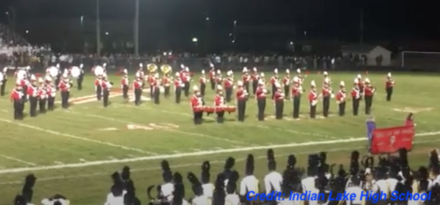
Introduction
Illustration: A Band in Need of Change

Slide 42
Review
God can use people who are:
Bold and Full of Flaws
Serving in the Background
Weak in Faith

Slide 43
Mark 1:16–20
Jesus’ Invitation:
“Follow Me…”
“I will make you become…”
“Fishers of men.”
CHANGE Required:
Change of Direction
Change of Identity
Change of Activity

Slide 44
Main Idea
Jesus transforms those who spend time with Him.
Questions:
How do we follow Jesus more closely?
How do we become who He wants us to be?
How do we operate in this identity?

Slide 45
James “the Less”
POINT: God can use people who appear to be insignificant.
Don’t judge outwardly.
Don’t be discouraged.

Slide 46
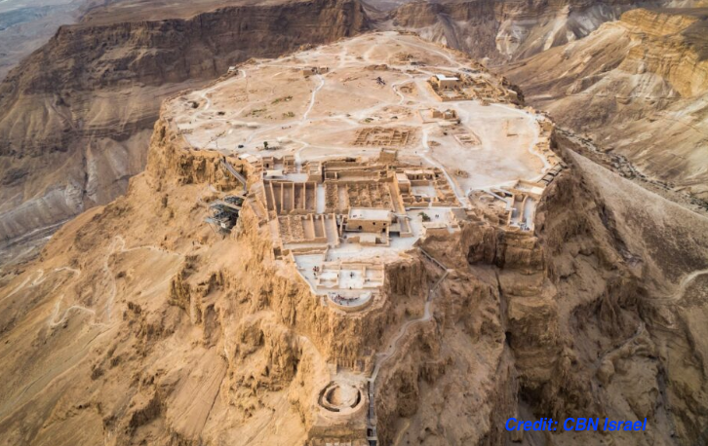
Simon the Zealot
The Zealots in the first century-Plateau at Masada:

Slide 47
Simon the Zealot
POINT: God can use those with a wild past.
Don’t judge others or yourself-based on the past.
Our allegiances and priorities may have to change.

Slide 48
Thaddaeus
(Judas, son of James)
The only words recorded which he spoke (John 14)
The key question: “What has happened that you are going to reveal yourself to us?”

Slide 49
Thaddaeus
(Judas, son of James)
POINT: God can use people who are virtually unknown.
Do you want to be known by God?
Freedom from performance-based acceptance!

Slide 50
MAIN IDEA
Jesus promised the Holy Spirit who would transform those who want to spend their lives with Him.

Slide 51
Application
Our Past, Present and Future Transformed
What are you willing to die for?
Do you limit yourself or others?
Are you okay with being “unknown” by this world?

Slide 53
Yet Not I but Through Christ in Me

Slide 54
What gift of grace is Jesus my Redeemer,
There is no more for heaven now to give,

Slide 55
He is my joy, my righteousness, and freedom,
My steadfast love, my deep and boundless peace,

Slide 56
To this I hold, my hope is only Jesus,
For my life is wholly bound to His,

Slide 57
Oh how strange and divine, I can sing; all is mine–
Yet not I, but through Christ in me.

Slide 58
The night is dark but I am not forsaken,
For by my side, the Savior He will stay,

Slide 59
I labor on in weakness and rejoicing,
For in my need, His power is displayed,

Slide 60
To this I hold, my Shepherd will defend me,
Through the deepest valley He will lead,

Slide 61
Oh the night has been won, and I shall overcome–
Yet not I, but through Christ in me.

Slide 62
No fate I dread, I know I am forgiven,
The future sure, the price it has been paid,

Slide 63
For Jesus bled and suffered for my pardon,
And He was raised to overthrow the grave,

Slide 64
To this I hold, my sin has been defeated,
Jesus now and ever is my plea,

Slide 65
Oh the chains are released, I can sing: I am free–
Yet not I, but through Christ in me.

Slide 66
With every breath I long to follow Jesus,
For He has said that He will bring me home.

Slide 67
And day by day I know He will renew me,
Until I stand with joy before the throne.

Slide 68
To this I hold, my hope is only Jesus,
All the glory evermore to Him!

Slide 69
When the race is complete, still my lips shall repeat:
Yet not I, but through Christ in me.

Slide 70
To this I hold, my hope is only Jesus,
All the glory evermore to Him!

Slide 71
When the race is complete, still my lips shall repeat:
Yet not I, but through Christ in me.

Slide 72
When the race is complete, still my lips shall repeat:
Yet not I, but through Christ in me.

