Slide 1
“The Son of God and His Winning Team”
Luke 9:18–36

Slide 2
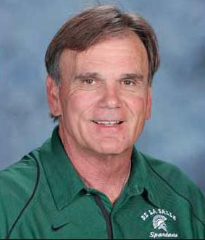
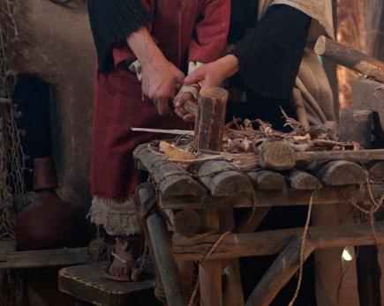
Introduction
The Rise from Obscurity
Bob Ladouceur
Bay Area Sports
Hall of Fame Picture
A Carpenter from Nazareth

Slide 3
Luke 9:18–26
Peter’s confession of Jesus as the Son of God
Requirements for following the Son of God
Jesus’ transfiguration as proof that He is the Son of God

Slide 4
vs. 18–22—Peter’s confession of Jesus as the Son of God
POINT: Jesus is the Son of God, the Christ, who would suffer, be rejected, die and raise from the dead
Application: We must accept the need for a suffering savior. We are sinful, under God’s wrath.

Slide 5
vs. 23–24—The requirements for following the Son of God
POINT: A disciple’s life is marked by death to self and living hope.
Application: A disciple must be willing suffer, endure rejection, die to self and hope in the resurrection.

Slide 6
vs. 25–27—The Warning
POINT: Don’t be among those who reject Christ.
Application: Die to my selfish ways.

Slide 7
vs. 28–36—Heavenly Testimony of Jesus’ Sonship
POINT: All God’s work through history is embodied in Jesus, the Son of God.
Application: Listen to Him!

Slide 8
Application—
Death to self, Christ is Life
We can suffer gracefully (1 Peter 4:17–19)
We can endure rejection (Titus 3:4–7)
We can deny our fleshly nature (Gal 5:24–25)
We can hope in the resurrection (Luke 21:27–28)

