Slide 1
The Call to Prayer
Luke 11:1–13

Slide 2
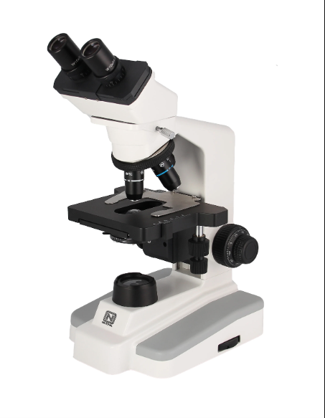
Introduction
Microscope. Magnifies details / data.
Beauty of creation more clearly seen.
The microscope must be calibrated,
used correctly.
Our purpose is to magnify God.
Calibration required is yielding
to the Holy Spirit

Slide 3
Review
Discipleship is about being with Jesus, not doing things for Him.

Slide 4
Luke 11:1–4
MAIN IDEA:
The call to discipleship is a call to prayer.

Slide 5
Luke 11:5–7
Acknowledge our need of God’s resources.

Slide 6
Luke 11:8–10
Persistence pays off.

Slide 7
Luke 11:11–12
Trust in the Father’s character.
“Give the Holy Spirit…”
Prayers should be spiritual in nature.

Slide 8
Application—
Praying in the Spirit
Admitting our inability to pray. Magnifies the Holy Spirit’s power.
Enjoying living communion with God. Magnifies the Father’s love and purpose.
Pleading with holy boldness. Magnifies the Son’s grace and kindness.

Slide 9
Conclusion
Our prayer lives calibrate us to magnify God.
How will you practice this:
  in personal time with God?
  in fellowship with the church?
  in your outreach to the lost?

