Slide 1
The Greatest Power
Luke 11:14–28

Slide 2


Introduction
Call to prayer: admitting our need.

Slide 3
Luke 11:14–28
vs. 14–16…Question of the source of Jesus’ power
vs. 17–19…”A kingdom divided”
Israel
satan’s kingdom
“Sons” referred to Jesus’ disciples
Those who submitted to Jesus’ authority were the ones able to cast out demons.

Slide 4

Luke 11:14–28
vs. 20–23…POINT: Jesus’ kingdom prevails over satan and every earthly kingdom.
THREE KINGDOMS:

Slide 5
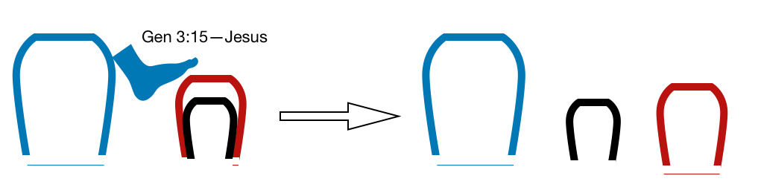
Luke 11:14–28
vs. 20–23…POINT: Jesus’ kingdom prevails over satan and every earthly kingdom.
THREE KINGDOMS:

Slide 6
Luke 11:14–28
vs. 20–23…POINT: Jesus’ kingdom prevails over satan and every earthly kingdom.
“he who is not with Me is against Me…” There is no middle ground. You either stand with Jesus or you don’t.
“he who does not gather with Me scatters…” The invitation is to gather to Jesus himself (preview Lk 13:34). The scattering further weakens and isolates.

Slide 7
Luke 11:14–28
vs. 24–26… They wanted to continue to rely on their natural life, not submissive to Christ.
vs. 27–28…We all think someone like us should get the credit, attention, accolades.
POINT: The source of Jesus’ power was submission to God the Father.

Slide 8
MAIN IDEA
Jesus has power over every spiritual and earthly power.
FCF: We submit to the wrong kingdom, rely on earthly and demonic power.

Slide 9

The Gospel Solution
1) Don’t rely on your own power
2) Don’t give credit to anything other than Christ
3) Be vigilant. We are at war.
IN CHRIST

Slide 10
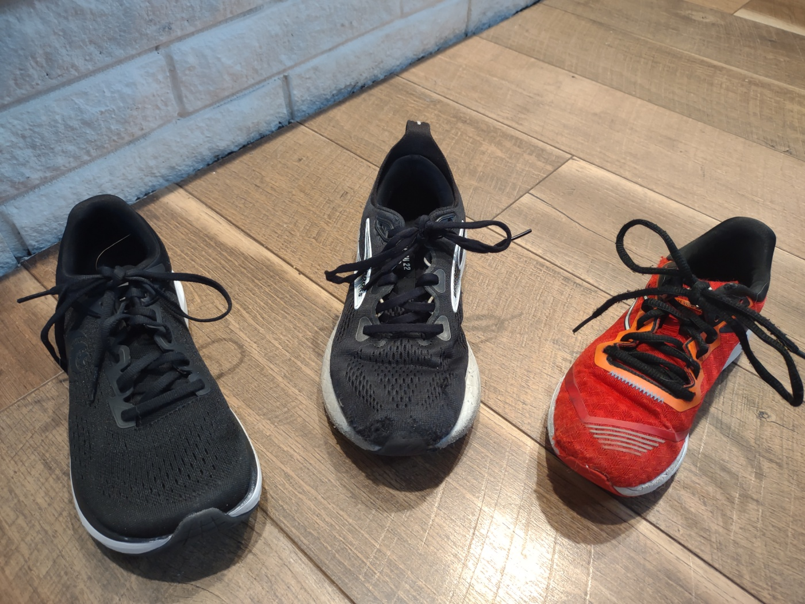
Reflection
1) Where are you relying on your own strength?
2) Do you feel like you are fighting a losing battle? Look to Jesus!
3) Where are you giving credit to someone other than Jesus? Is it merited?

