Slide 1
“Investing Wisely”
Luke 19:1--27

Slide 2

Introduction:
A house redeemed, reconciled and restored

Slide 3
Context / Review
Jesus’ promises and presence are certain.
God receives those who are persistent in prayer, humble, needy.

Slide 4
Luke 19:1-10
Zacchaeus’ past: the worst sinner!
Zacchaeus’ present: truly repentant.
Zacchaeus’ future: “Salvation has come to this house…”

Slide 5
Luke 19:1-10
What was lost?
  Souls.
  Proper worship.
  Knowledge of God’s kingdom.
  Faith.

Slide 6
MAIN IDEA
Jesus redeems His people, reconciles worship, and restores His kingdom.

Slide 7
APPLICATION
Jesus’ redemption – Believe and identify.
Jesus’ reconciliation – Yield to the Holy Spirit.
Jesus’ restoration – Fix your hope on His kingdom.

Slide 8
Parable of the Minas—Four scenes
Nobleman goes to receive a kingdom.
Two faithful servants.
Unfaithful servant.
Addressing the “bystanders.”

Slide 9
Meaning of the Parable
Nobleman: Jesus.
Distant country to receive a kingdom: Jesus’ kingdom would not be immediate.
Ten slaves: Jesus’ people entrusted with His work.

Slide 10
Meaning of the Parable
Ten minas: Relationship and word of the kingdom (redemption, reconciliation, restoration).
Citizens: Nation of Israel.
Faithful slaves’ investment: Growing relationship and sharing the kingdom with all.

Slide 11
Meaning of the Parable
Authority of cities given to faithful: Rewards when Christ’s kingdom comes visibly.
Unfaithful slave: entitled and selfish.

Slide 12
Meaning of the Parable
Bystanders: Angels.
Enemies: those who hate Jesus’ reign.
“Slay them in my presence”: Unrepentant sinners under God’s wrath.

Slide 13
POINT of the Parable
Jesus has been given all authority, and faithful disciples invest in His kingdom.
NOT just doing things for Him.

Slide 14
Investing in Jesus’ Kingdom:
Grow in your understanding of Christ’s redemption—holistic.
Reconciliation of worship through yielding to the Holy Spirit.
Hope in the restored kingdom, creation.

Slide 15
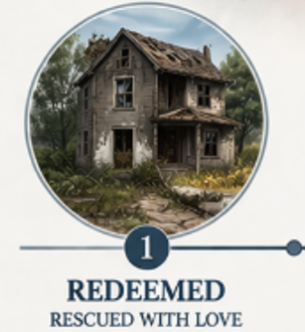


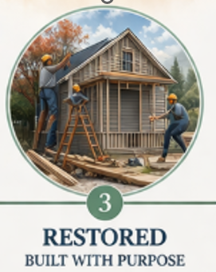
CONCLUSION
1 Cor 6:19

