Slide 1
“Signs of Life”
Luke 17:20--37

Slide 2
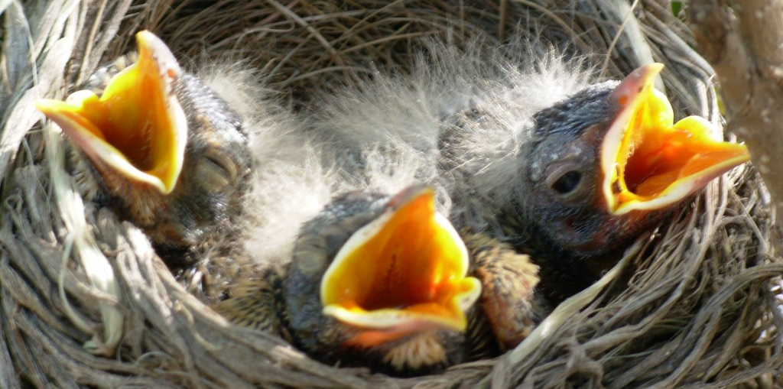
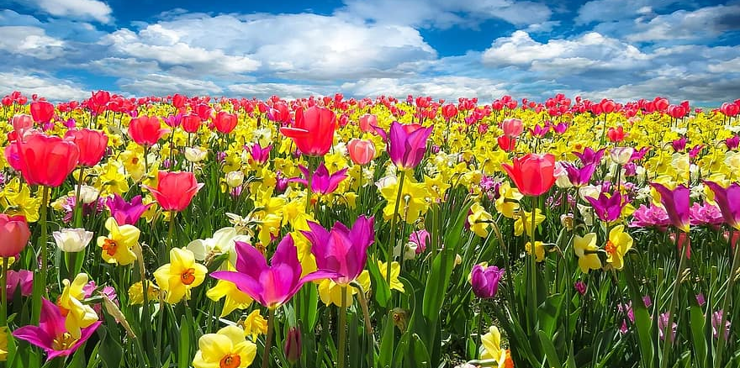

Introduction Signs of Life in Spring
The GOSPEL: Invitation to renewed life
Joy, Hunger Expressed
Growth and Change
Increasing Love
This Photo by Unknown Author is licensed under CC BY-SA

Slide 3
Luke 17:20-21
POINT: Jesus was the sign, and his disciples will be signs.

Slide 4
Luke 17:22--25
POINT: True disciples long for the day of final establishment of Christ’s kingdom.

Slide 5
Luke 17:26--27
POINT: Life is not about what you can accomplish. It is about obedience to Christ.

Slide 6
Luke 17: 28-33
POINT: The past/former life has nothing life-giving apart from Christ.

Slide 7
Luke 17: 34--37
POINT: The judgment is that a man is dead apart from Christ.

Slide 8
MAIN IDEA
You can be a sign of life in Christ or a sign of death.

Slide 9
It is not about us being right:
Application
Theology before hunger for Christ.
Inflexible practices rather than growth.
Self-defined spirituality rather than self-giving love.

Slide 10
Emphasis on Readiness, Renewed Life
Joy / Hunger
Change / Growth
Increasing Love
This Photo by Unknown Author is licensed under CC BY-SA

