Slide 2
The Heart Of Worship
CCLI Song # 2296522
Matt Redman
© 1999 Thankyou Music Ltd
For use solely with the SongSelect® Terms of Use.
All rights reserved. www.ccli.com
CCLI License # 73926

Slide 3
When the music fades all is stripped away
And I simply come
Longing just to bring
something that's of worth
That will bless Your heart

Slide 4
I'll bring You more than a song
For a song in itself
is not what You have required
You search much deeper within
Through the way things appear
You're looking into my heart

Slide 5
I'm coming back to the
heart of worship
And it's all about You
all about You Jesus
I'm sorry Lord
for the thing I've made it
When it's all about You
all about You Jesus

Slide 6
King of endless worth
no one could express
How much You deserve
Though I'm weak and poor
all I have is Yours
Ev'ry single breath

Slide 7
I'll bring You more than a song
For a song in itself
is not what You have required
You search much deeper within
Through the way things appear
You're looking into my heart

Slide 8
I'm coming back to the
heart of worship
And it's all about You
all about You Jesus
I'm sorry Lord
for the thing I've made it
When it's all about You
all about You Jesus

Slide 9
I'm coming back to the
heart of worship
And it's all about You
all about You Jesus
I'm sorry Lord
for the thing I've made it
When it's all about You
all about You Jesus

Slide 10
It’s all about You
It’s all about You, Jesus

Slide 12
#48 HM&A His Robes For Mine
His robes for mine: o wonderful exchange!
clothed in my sin, Christ suffered ‘neath God’s rage.
draped in His righteousness, I’m justified.
in Christ I live, for in my place He died.
Song Used With permission – 7120053 CCLI - 11614006

Slide 13
I cling to Christ, and marvel at the cost:
Jesus forsaken, God estranged from God.
bought by such love, my life is not my own.
my praise-my all-shall be for Christ alone.
Song Used With permission – 7120053 CCLI - 11614006

Slide 14
His robes for mine: what cause have I for dread?
God’s daunting law Christ mastered in my stead.
faultless I stand with righteous works not mine,
saved by my lord’s vicarious death and life.
Song Used With permission – 7120053 CCLI - 11614006

Slide 15
I cling to Christ, and marvel at the cost:
Jesus forsaken, God estranged from God.
bought by such love, my life is not my own.
my praise-my all-shall be for Christ alone.
Song Used With permission – 7120053 CCLI - 11614006

Slide 16
His robes for mine: God’s justice is appeased.
Jesus is crushed, and thus the Father’s pleased.
Christ drank God’s wrath on sin,
then cried “‘tis done!”
sin’s wage is paid; propitiation won.
Song Used With permission – 7120053 CCLI - 11614006

Slide 17
I cling to Christ, and marvel at the cost:
Jesus forsaken, God estranged from God.
bought by such love, my life is not my own.
my praise-my all-shall be for Christ alone.
Song Used With permission – 7120053 CCLI - 11614006

Slide 18
His robes for mine: such anguish none can know.
Christ, God’s beloved, condemned as though His foe.
He, as though I, accursed and left alone;
I, as though He, embraced and welcomed home!
Song Used With permission – 7120053 CCLI - 11614006

Slide 19
I cling to Christ, and marvel at the cost:
Jesus forsaken, God estranged from God.
bought by such love, my life is not my own.
my praise-my all-shall be for Christ alone.
Song Used With permission – 7120053 CCLI - 11614006

Slide 21
1 Peter 2:9-12 NASB
9 But you are a chosen people, a royal priesthood, a holy nation, a people for God’s own possession, so that you may proclaim the excellencies of Him who has called you out of darkness into His marvelous light; 10 for you once were not a people, but now you are the people of God; you had not received mercy, but now you have received mercy.
11 Beloved, I urge you as foreigners and strangers to abstain from fleshly lusts, which wage war against the soul. 12 Keep your behavior excellent among the Gentiles, so that in the thing in which they slander you as evildoers, they may because of your good deeds, as they observe them, glorify God on the day of visitation.

Slide 23
#373 Only One Life
Only one life to offer - Jesus, my Lord and King;
Only on tongue to praise
Thee And of Thy mercy sing (forever);
Only one heart's devotion - Savior, O may it be
Consecrated alone to Thy matchless glory,
Yielded fully to Thee.
Song Used With permission – 7120053 CCLI - 11614006

Slide 24
Only this hour is mine, Lord –
May it be used for Thee;
May ev'ry passing moment Count for eternity (my Savior);
Souls all about are dying, Dying in sin and shame;
Help me bring them the message of Calv'ry's redemption In Thy glorious name.
Song Used With permission – 7120053 CCLI - 11614006

Slide 25
Only one life to offer - Take it, dear Lord, I pray;
Nothing from Thee withholding,
Thy will I now obey (my Jesus);
Thou who hast freely given Thine all in all for me,
Claim this life for Thine own,
to be used, my Savior,
Ev'ry moment for Thee.
Song Used With permission – 7120053 CCLI - 11614006

Slide 27
#333 Open Our Eyes Lord
Open our eyes, Lord,
we want to see Jesus,
to reach out and trust him,
and say that we love him
Song Used With permission – 7120053 CCLI - 11614006

Slide 28
Open our ears, Lord,
and help us to listen
Open our eyes, Lord,
we want to see Jesus
Song Used With permission – 7120053 CCLI - 11614006

Slide 29
Open our eyes, Lord,
we want to see Jesus,
to reach out and trust him,
and say that we love him
Song Used With permission – 7120053 CCLI - 11614006

Slide 30
Open our ears, Lord,
and help us to listen
Open our eyes, Lord,
we want to see Jesus
Song Used With permission – 7120053 CCLI - 11614006

Slide 32
“Waiting for Jesus” part 1
Luke 21:1-19

Slide 33


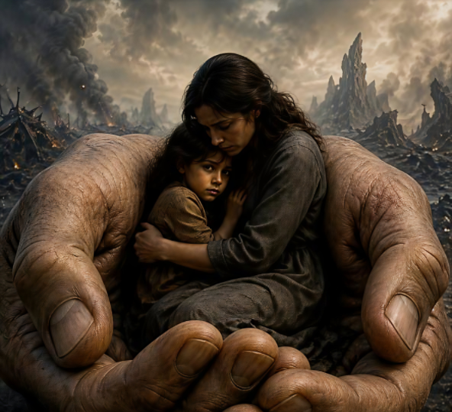
Introduction
Unconditional love and trust.

Slide 34
Luke 21:1-4
POINT: The woman recognized she belongs to God.

Slide 35
Luke 21:5-6
POINT: The Jews’ understanding of worship had to change

Slide 36
Luke 21:7-11
POINT: Don’t fear or be misled in this hostile world.

Slide 37
Luke 21:12-19
POINT: People will hate the Christ-life in you, but don’t fear.
“By your endurance you will gain your lives”

Slide 38
MAIN IDEA
Those sharing in the life of Christ can endure in the midst of hostility.

Slide 39
Application
Our natural lives and physical possessions are his.
Our paradigms for life and worship must be changed.
Our understanding must be shaped by His true word.

Slide 40
Application
Our fear of this world must be let go.
Our fear of man must be let go.
Our testimony must be shared.

Slide 41

Conclusion
Safely rest in
Jesus’ hands

Slide 43
#274 Will Jesus Find Us Watching
When Jesus comes to reward His servants, Whether it be noon or night,
Faithful to Him will He find us watching,
With our lamps all trimmed and bright?
Song Used With permission – 7120053 CCLI - 11614006

Slide 44
O can we say we are ready, brother? Ready for the soul's bright home? Say, will He find you and me still watching, Waiting, waiting when the Lord shall come?
Song Used With permission – 7120053 CCLI - 11614006

Slide 45
If, at the dawn of the early morning, He shall call us one by one,
When to the Lord we restore our talents, Will He answer you- "Well done"?
Song Used With permission – 7120053 CCLI - 11614006
Song Used With permission – 7120053 CCLI - 11614006
CCLI - 11614006
sed With permission –

Slide 46
O can we say we are ready, brother? Ready for the soul's bright home? Say, will He find you and me still watching, Waiting, waiting when the Lord shall come?
Song Used With permission – 7120053 CCLI - 11614006

Slide 47
Have we been true to the trust He left us? Do we seek to do our best?
If in our hearts there is naught condemns us, We shall have a glorious rest.
Song Used With permission – 7120053 CCLI - 11614006
Song Used With permission – 7120053 CCLI - 11614006
CCLI - 11614006
sed With permission –

Slide 48
O can we say we are ready, brother? Ready for the soul's bright home? Say, will He find you and me still watching, Waiting, waiting when the Lord shall come?
Song Used With permission – 7120053 CCLI - 11614006

Slide 49
Blessed are those whom the Lord finds watching, In His glory they shall share;
If He shall come at the dawn or midnight, Will He find us watching there?
Song Used With permission – 7120053 CCLI - 11614006
Song Used With permission – 7120053 CCLI - 11614006
CCLI - 11614006
sed With permission –

Slide 50
O can we say we are ready, brother? Ready for the soul's bright home? Say, will He find you and me still watching, Waiting, waiting when the Lord shall come?
Song Used With permission – 7120053 CCLI - 11614006

