Slide 1
“Marks of Faith”
Luke 18:1--27

Slide 2



Introduction
Context: Jesus spoke of His kingdom
3 Sections—notice contrasts

Slide 3
Luke 18: 1-8
Contrast: Unrighteous Judge and God
POINT: Faith in Jesus is marked by persistent prayer
Trust in God’s character

Slide 4
Luke 18: 9-14
Contrast: Pharisee and tax collector
POINT: Faith in Jesus is marked by humility

Slide 5
Luke 18:15-25
Contrast: Children and rich young ruler
POINT: Faith in Jesus is marked by need.

Slide 6
MAIN IDEA
God receives those who are persistent, humble and needy.

Slide 7
Application
Be persistent in prayer to overcome the natural.
Be humble in attitude to overcome need for importance.
Be needy in action to overcome challenges of life.

Slide 8
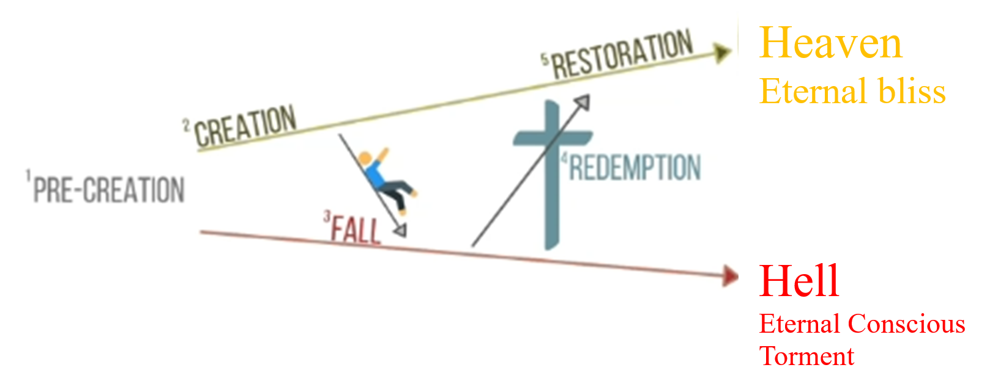
Application Two types of Life
Eternal Life—Christ’s Life
Natural Life

Slide 9
Conclusion
1. How are you relying on your own resources rather than on Jesus?
2. How are you thinking more highly of yourself than someone else?
3. How is your prayer life?

